Slide 1
Telecom Analytics
Vijaykumar Gotakhindi
Batch 03
Business Analytics

Slide 2
Telecom Analytics
Telecom has become a very competitive space and to get the most out of their customers, the CMO of the telecom company wants to understand whether there has been any decreasing trend in the usage of the customers.
The usage of the customers have been defined here by the calls they’ve made on a weekly basis for 24 weeks and the amount spent.
Objectives:
You’re provided with customer profile data and their transaction data for 24 weeks. Create a single view of the customers. Derive some variables that can measure the premium-ness / discount seeking behavior of a customer such as the amount spent per call. Use these classifications for your analysis
You can also classify the data into different age bands and gender to see what customers have been performing well and what customers are showing a declining trend in their behavior.
Use time series analysis to identify if there are seasonal / cyclical components in your data on a weekly basis.
Validate statistically if the usage across different age bands and gender remain to be the same.
Any other objectives that you come across while evaluating and understanding the data will lead to additional points such as using Time series models to predict the usage of the customer for the coming 3 weeks.
Tools: SPSS Statistics , Excel

Slide 3
Descriptive Statistics

Slide 4
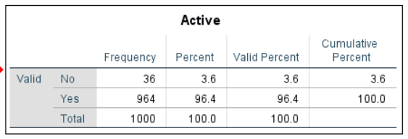
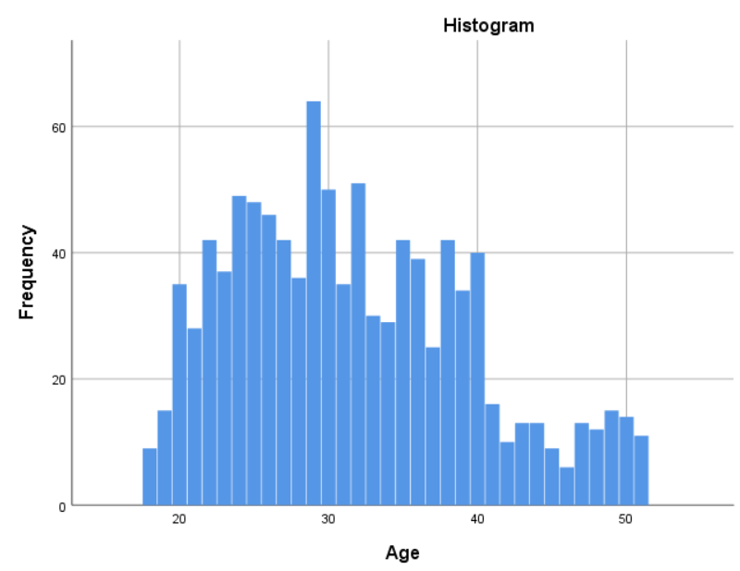
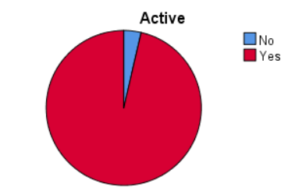
About Data
Total number of customers = 1000 Missing values = 0
Number of Active & Inactive customers
Age distribution
Minimum Maximum Mean Std. Deviation
Age 18 51 31.67 8.015

Slide 5
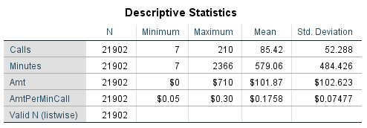
About Data contd..,

Slide 6
One Sample T-test

